Slide 1
Employees Burnout Analysis and Prediction

Slide 2

Student Details
Name : Pedapatnapu Poorvaja Veera Naga Durga
Skill Build Email Id : poorvajadurga@gmail.com
College Name : Bonam Venkata Chalamayya Institute of Technology and Science.
College State : Andhra Pradesh
Internship Domain : Artificial Intelligence
Internship Start and End Date : 5th June/2023 – 23rd July /2023

Slide 3
Problem Statement
Employee Burnout Analysis and Prediction
Burnout is a state of physical, emotional, and mental exhaustion caused by chronic workplace stress, leading to reduced productivity, diminished job satisfaction, and increased turnover rates.
Investigate Root Causes: Examine the organizational, job-related, and individual factors that contribute to employee burnout.
Identify Burnout Indicators: Analyze various physical, emotional, and behavioral indicators of burnout among employees to create a standardized measurement framework for assessing burnout levels accurately.
Predictive Modeling: Develop predictive models using historical data and machine learning techniques to anticipate and forecast instances of burnout among employees.

Slide 4
Agenda
Project Overview
Introduction to the Project
Purpose and Scope of the Analysis
Who Are The End Users
Human Resources (HR) Department
Managers and Team Leaders
Solution And Its Value Proposition
Overview of the Proposed Solution
How it Addresses Burnout Issues
Key Benefits and Value to End Users
Customization Of Project
Adapting to Different Work Environments
Flexibility and Scalability
Modelling
Data Collection and Preprocessing
Feature Selection and Engineering
Choice of Predictive Models
Results
Presentation of Analyzed Data
Burnout Prediction Performance Metrics
Project Links
Access to Project Resources and Data
GitHub Repository

Slide 5
1.Project Overview
In this project, we aim to conduct a comprehensive Employee Burnout Analysis & Prediction to address the growing concern of burnout in today's workplaces. Employee burnout is a state of physical, emotional, and mental exhaustion caused by chronic workplace stress, leading to reduced productivity, diminished job satisfaction, and increased turnover rates.
Our primary objective is to identify the key factors contributing to employee burnout by analyzing data from various industries and organizational settings. Through surveys, performance metrics, and other relevant sources, we will gather valuable insights into the prevalence and underlying causes of burnout.
By leveraging advanced statistical techniques and machine learning algorithms, we intend to develop a predictive model that can anticipate instances of burnout among employees. This model will aid in early detection and enable organizations to implement proactive measures to prevent burnout and promote employee well-being.

Slide 6
2.Who Are The End Users
The end users for Employee Burnout Analysis can vary depending on the context and purpose of the analysis. Here are some potential end users who could benefit from the insights and findings of the analysis:
Human Resources (HR) Department: The HR team plays a crucial role in managing employee well-being and organizational productivity. They can use the analysis to identify potential burnout risk factors, design employee support programs, and create strategies to promote a healthier work environment.
Managers and Team Leaders: Managers and team leaders are responsible for the day-to-day management of employees. They can use the analysis to recognize signs of burnout in their teams, offer appropriate support, and adjust workloads or responsibilities to prevent burnout.
Organizational Leadership and Executives: Senior management can utilize the analysis to understand the impact of burnout on organizational performance and make informed decisions about resource allocation, employee development, and initiatives to improve work-life balance.

Slide 7
3.Solution And Its Value Proposition
The solution we propose for Employee Burnout Analysis & Prediction is a comprehensive data-driven approach that combines advanced analytics and predictive modeling to tackle the issue of burnout in the workplace effectively.
Data Collection and Preprocessing:
The data is from various sources, including employee surveys, performance metrics, HR records, and other relevant data points.
Predictive Modeling:
Leveraging machine learning algorithms, we will build a robust predictive model capable of forecasting employee burnout.
Our Employee Burnout Analysis & Prediction solution offers several key benefits and value to organizations and their employees:
Early Detection and Prevention
Data-Driven Decision Making
Enhanced Employee Retention and Productivity

Slide 8
4.Customization Of Project
Customizing and making the Employee Burnout Analysis & Prediction project your own involves tailoring the approach, data, and insights to align with your specific goals and organization.
Define Your Objectives: Clarify the specific objectives you want to achieve with the analysis and prediction.
Data Collection and Preparation: Identify the relevant data sources within your organization that can be used for the analysis. This may include employee surveys, performance metrics, HR records, or other relevant data points. Ensure the data is properly cleaned, organized, and standardized for analysis.
Customize Features and Variables: Tailor the features and variables used in the analysis to match the unique characteristics of your organization and workforce.
Select Appropriate Models: Choose machine learning algorithms and statistical techniques that are best suited for your dataset and prediction goals. Experiment with different models to find the most accurate and reliable one for your specific use case

Slide 9
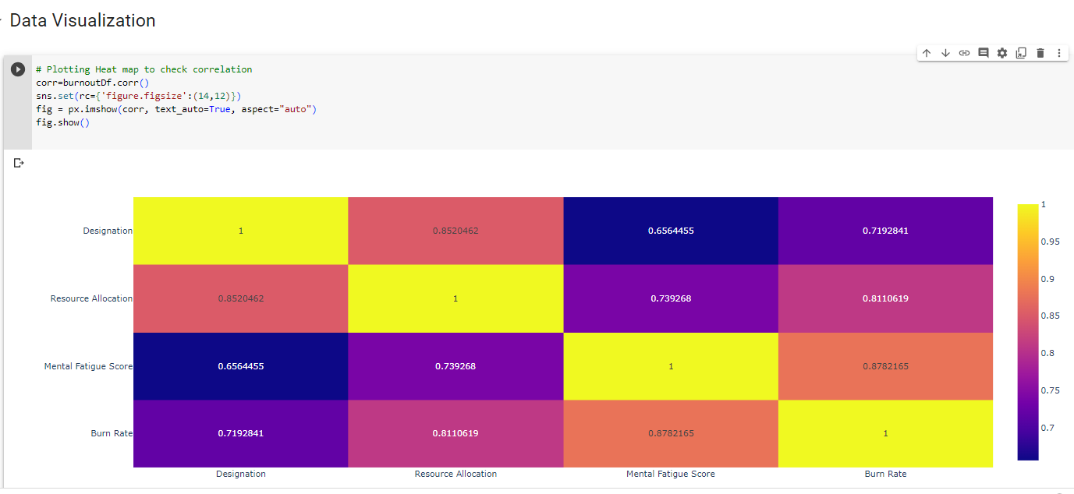
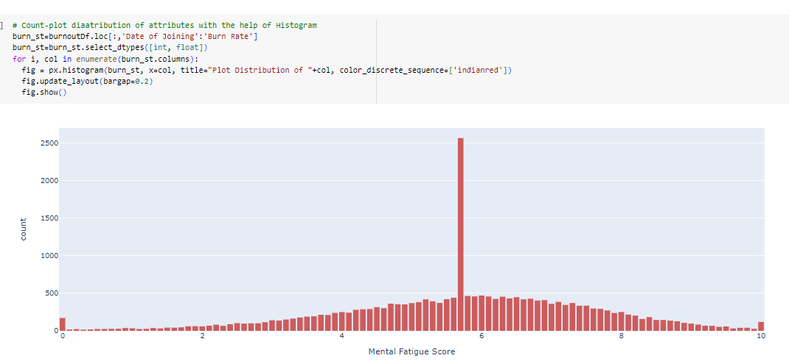
5. Modelling Of The Project
Techniques and Methodologies Used in Employee Burnout Analysis : Survey and Questionnaires , Descriptive Statistics, Correlation Analysis , Data Visualization , Regression Analysis , Machine Learning Algorithms , Cluster Analysis , Longitudinal Analysis

Slide 10
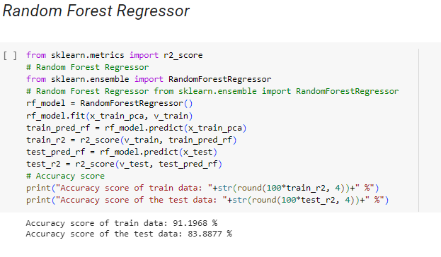
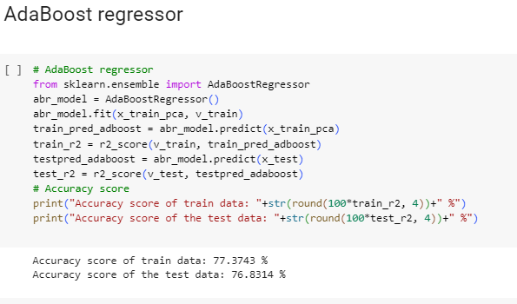
6.Result
After conducting the Employee Burnout Analysis & Prediction, we obtained insightful findings that shed light on the prevalence, contributing factors, and prediction of employee burnout in the workplace.
Successful Results

Slide 11
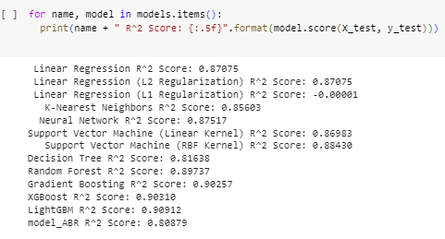


Slide 12
7.Project Links
Data Used In this Project :-
https://drive.google.com/file/d/1GlpSgCMCAz_yBWSdwaKQGM33cgN8H2XP/view?usp=sharing
Code For BurnOut Prediction :-
https://colab.research.google.com/drive/1j7vsefRNhh8dbtQ2f7LYHw8uVjjylTvE?usp=sharing
Code In Pdf :-
https://drive.google.com/file/d/1LT4TrCF8aSpfF4_HEUbwR0NcHnIREje3/view?usp=sharing

